Slide 1

Microsoft Azure Webinar Series: Getting Started with Azure David Gristwood – davidgri@microsoft.com Mike Ormond - mormond@microsoft.com slides: github.com/dxuk/AzureWebinars

Slide 2
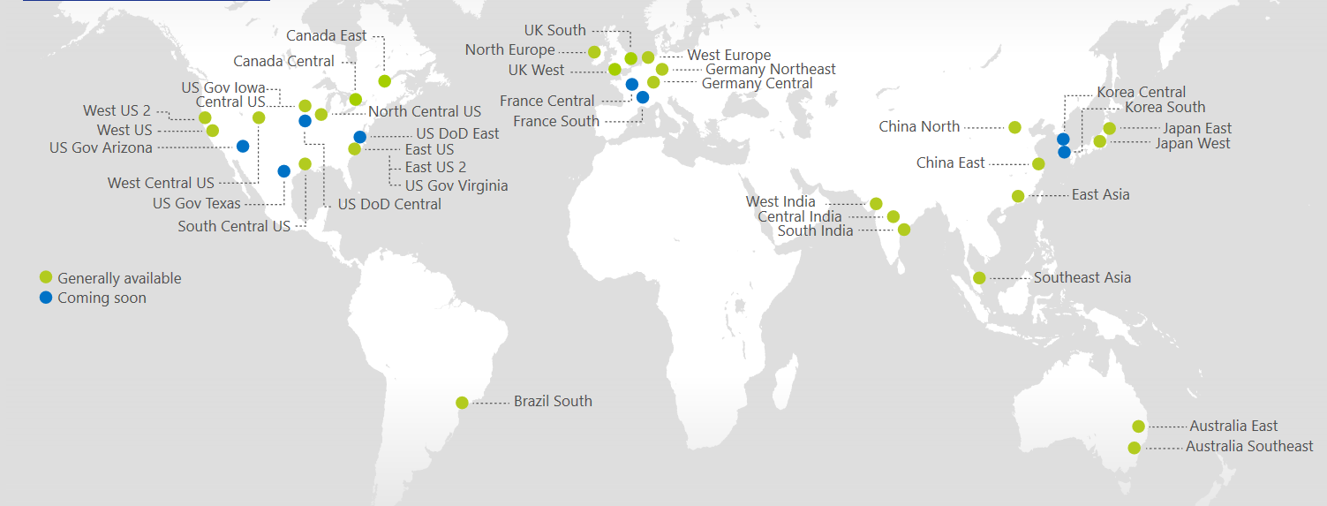
Azure Regions
https://azure.microsoft.com/regions/
Azure is generally available in 30 regions around the world, and has announced plans for 8 additional regions
Notes:
http://azuredatacentermap.azurewebsites.net/

Slide 3
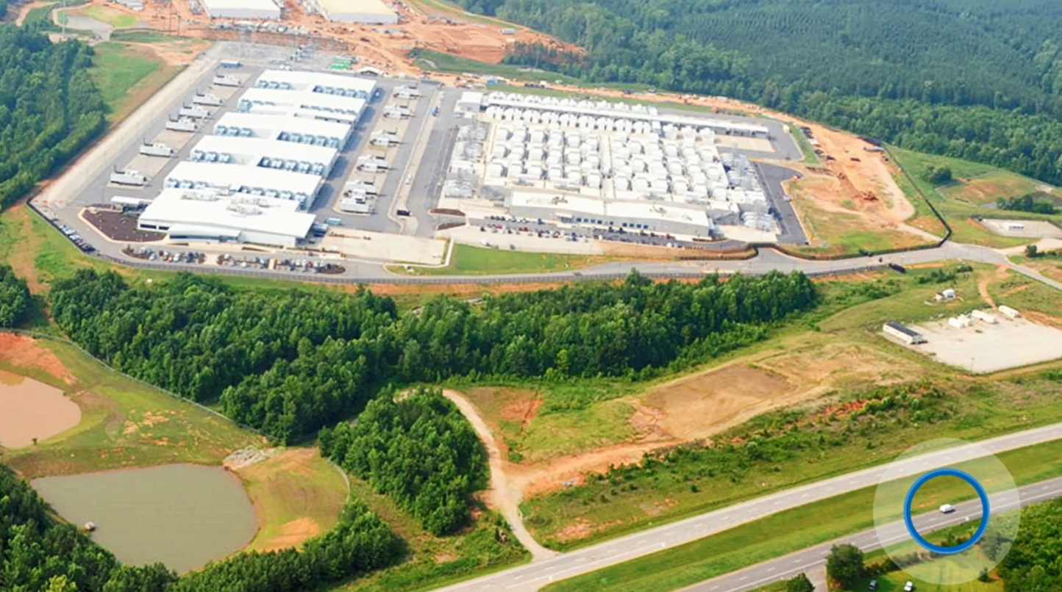

Slide 4
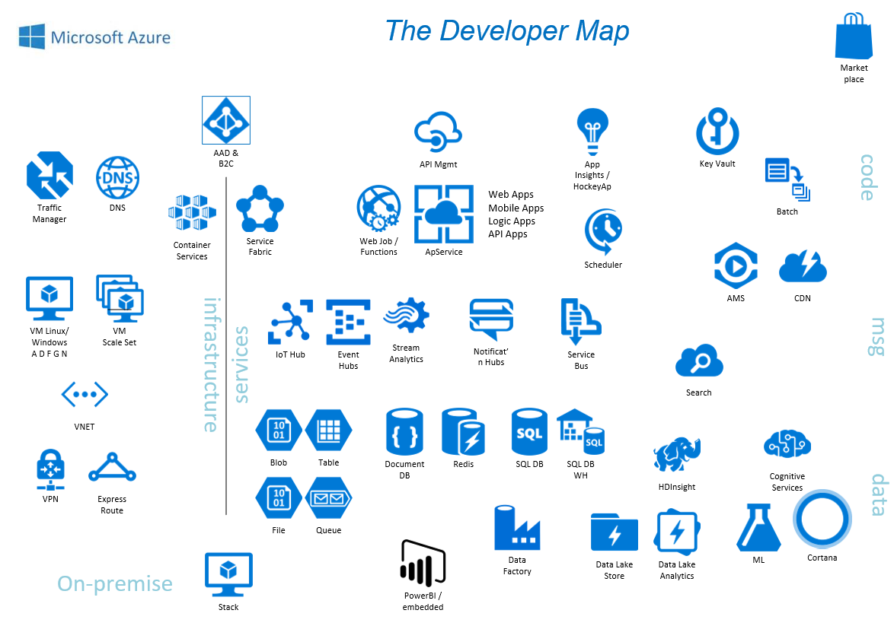

Slide 5
Infrastructure as a Service

Slide 6
The Hybrid Datacenter
Azure
Scale
Pay for what you use
Simple Dev / Test
Fast Provisioning
Integrated Operations
Automate
On-Premises Datacenter

Slide 7

IaaS
Network
Compute
Storage

Slide 8
Network
Compute
Storage

Slide 9
Virtual Machine Storage Architecture
Azure Virtual Machine
C:\
OS Disk
D:\
Temporary Disk
(Contents can be lost)
E:\, F:\, etc.
Data Disks
Azure Blob
Storage
Up to 1TB Disks
Highly available and redundant
Disks can be combined
Standard
Premium (SSD)

Slide 10
Network
Compute
Storage

Slide 11
Compute Families
Family | Description
A-series | cost-effective, general purpose compute
D(S) -series | cost-effective, general purpose compute (faster CPU and local SSD)
F(s)-series | best value compute capability per core, lower memory footprint
G(S)-series | highest memory footprint
H-series | very high end workloads (eg CFD)
N-series | GPU-enabled. NV for visualisation, NC for compute
All apart from A-series have an SSD temporary disk (D:\)
‘S’ indicates premium storage option (ie SSD for OS / Data drives)
- eg D1 (HDD) vs DS1 (SSD)
For some families there is a “v2” eg Dv2 or DSv2
- This represents the next iteration, typically better specification
Machine family and size determine price
Not all machine sizes are available in all regions

Slide 12
Compute Families Example
A2v2 or “Standard_A2_v2”
2 CPU cores, 4GB Memory
20GB local SSD
Limit of 4 data disks
No premium storage option
A
DS4 or “Standard_DS4”
8 CPU cores, 28GB Memory
56GB local SSD
Limit of 16 data disks
Premium storage option
D

Slide 13

Availability & Scaling
Availability Set
Scale Set
Virtual Machine
Virtual Machine
Auto scale set of VMs
No pre-provisioning
Implicit availability set
1
SQL Server
Primary
SQL Server
Secondary
1
2
n
SLA 99.95
Deploy across fault / update domains

Slide 14
Network
Compute
Storage

Slide 15
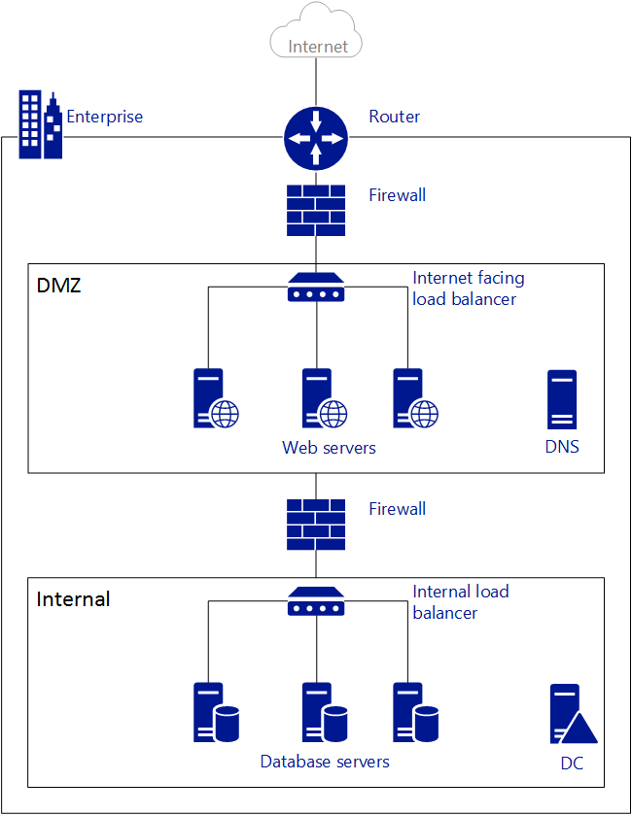
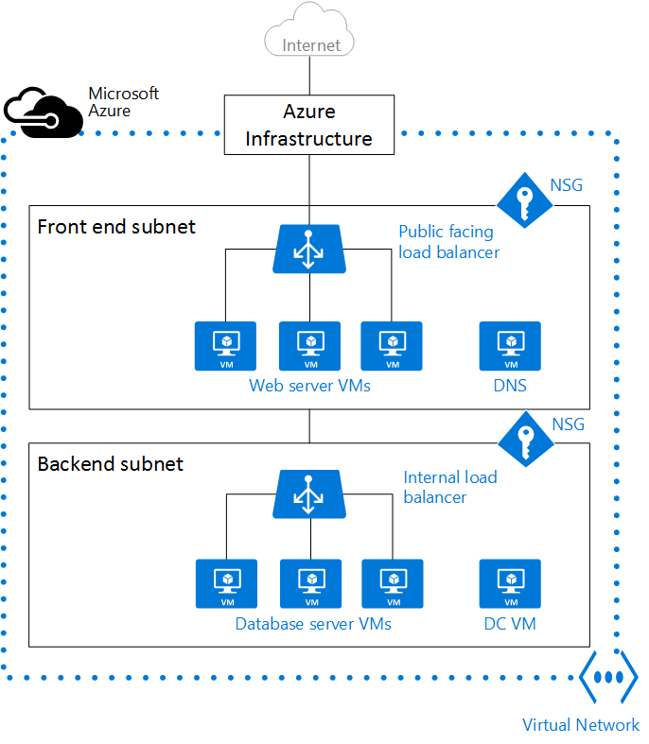
Networking
On Premise
Azure

Slide 16
Networking
On Premise Network | Azure Network
Router device | Azure infrastructure
Firewall appliance | Network Security Group (NSG)
Load Balancer device | Azure load balancer
Virtual Networks (VNet) provide network isolation
NSG define security boundaries
Traffic entering / leaving resources in a VNet controlled with NSG
Resources have access to public internet by default
Resources within a VNet can communicate using private IP addresses
VNets can be connected to each other and to on-premise datacentres
- Vnet peering or network gateway
- Site to site VPN or ExpressRoute

Slide 17
Automation & Management
Which OSs are supported?
Windows and Linux VM images in all sorts of flavours
- eg Vanilla Windows Server 2012R2 to HA AD Domain with 2 load balanceDCs
- eg Vanilla Ubuntu 16.04 VM to Drupal 8 in a VM Scale Set with MySQL
Where can I get VM images?
Upload your own
Adopt / adapt a predefined template from marketplace, GitHub etc
Deployment
Azure Resource Manager (ARM)
- Service – Provides the logic, orchestration etc
- Templates - Declarative mechanism to describe a deployment of a group of resources
- API – Consistent access layer for PowerShell, CLI, Portal, REST API, development tools etc
(Optional) - Desired State Configuration (DSC) to configure the VMs
- eg PowerShell DSC, Chef etc

Slide 18
Platform as a Service

Slide 19
Platform as a Service
We provide services your application can use
We manage, maintain, upgrade, scale and generally look after these service automatically
You pay only for what you use
Very much along the ideas of microservice design, serverless computing
Popular ones:
Azure App Services for web sites
Azure SQL Database for SQL Server
Azure Functions for event code

Slide 20
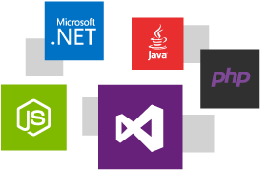
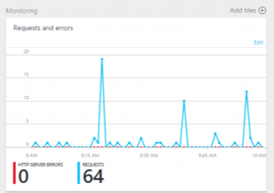
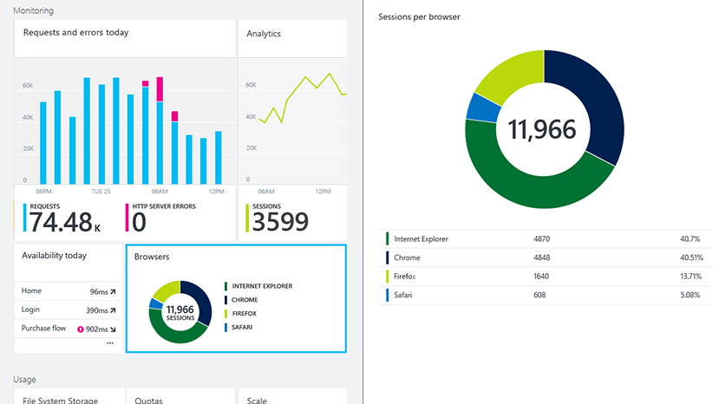
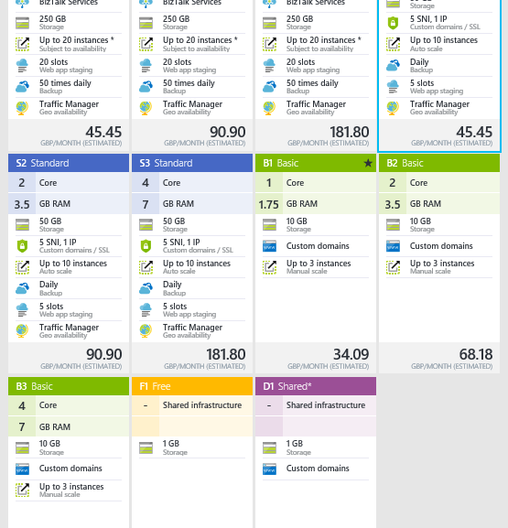
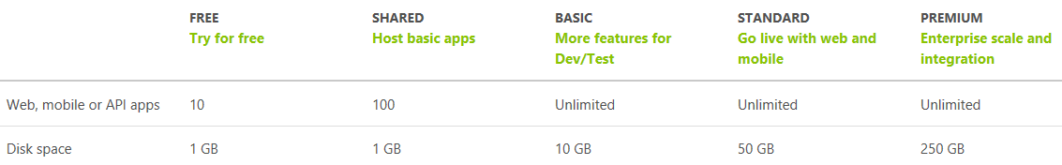
Azure App Services
Web site as a service
+ Web APIs and more
Auto-scale, monitoring, …
Pay for the functionality you need

Slide 21
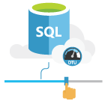
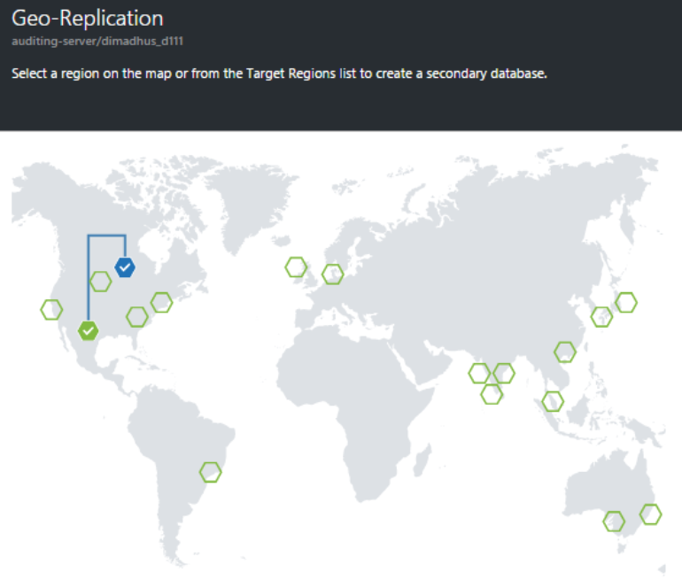
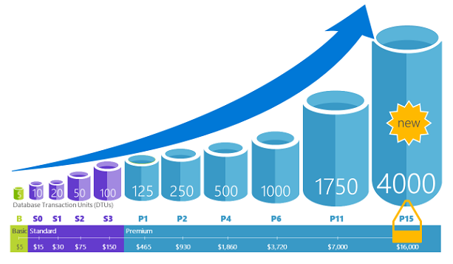
SQL Database
Database as a service
Service Tiers & Performance Levels to match needs
Geo-replicate, restore points…
Elastic pools for efficient multi-tenant
DTU is a blended measure of CPU, memory, and data I/O and transaction log I/O in a ratio determined by an OLTP benchmark workload designed to be typical of real-world OLTP workloads

Slide 22

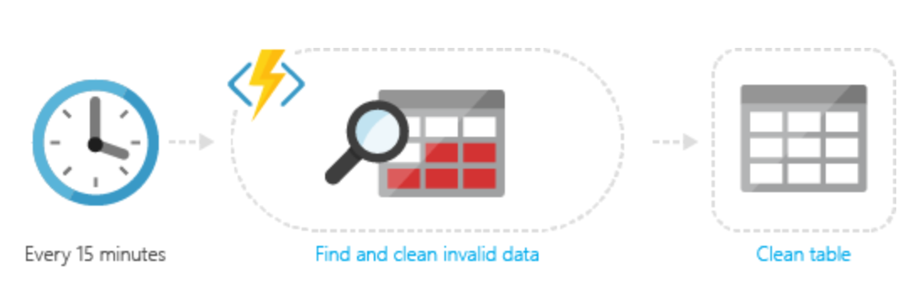
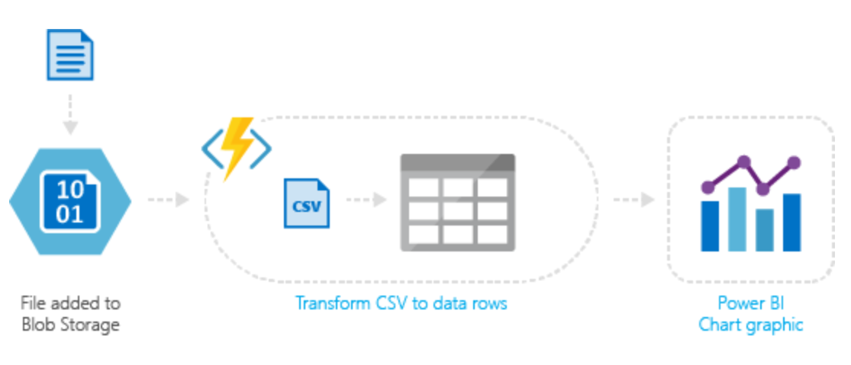
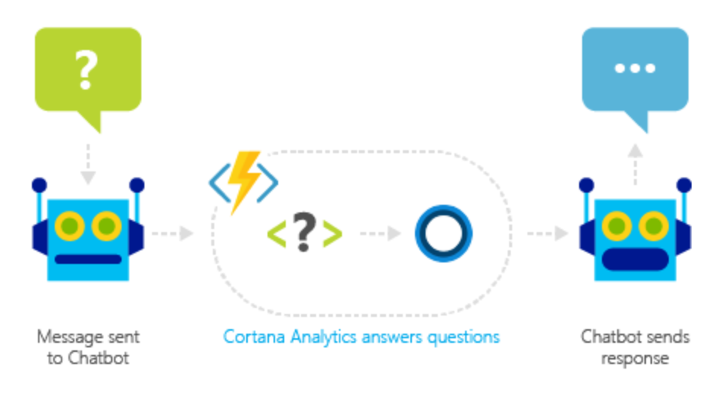
Azure Functions
Process events with a serverless code architecture
Event driven model
Pay only for what you use
JavaScript, C#, Python, PHP, Bash, Batch, and PowerShell

Slide 23
Azure Portal

Slide 24
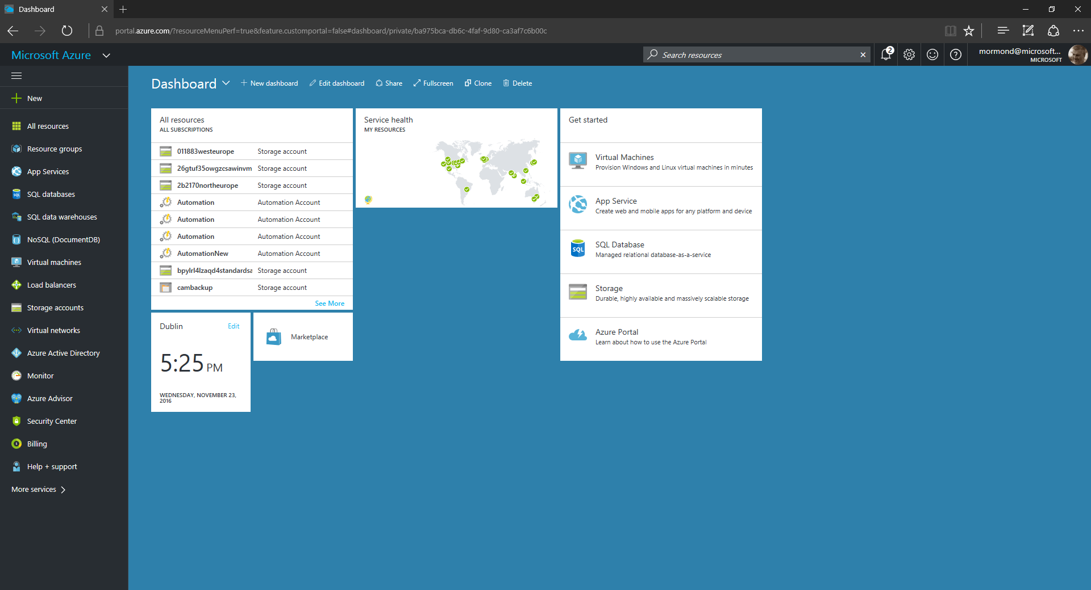

Slide 25
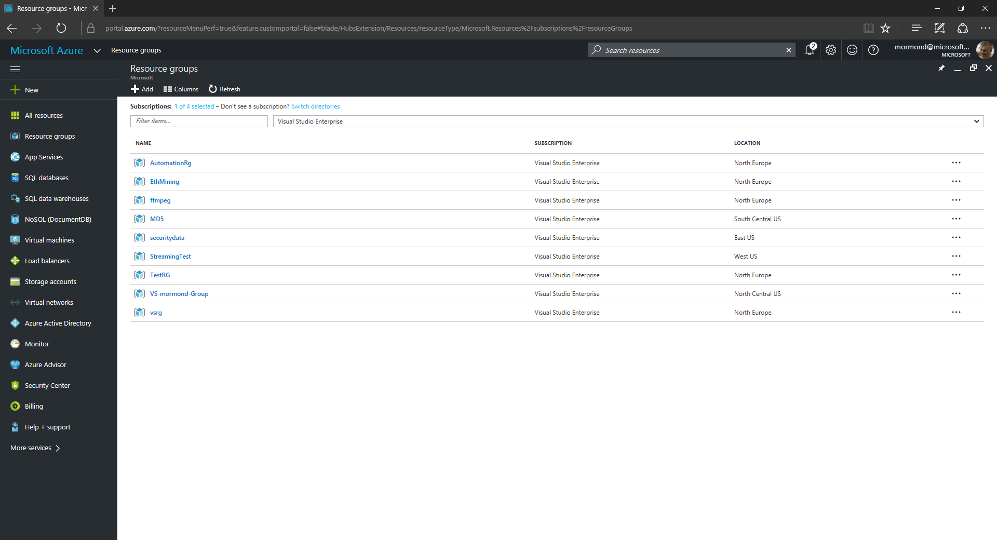

Slide 26
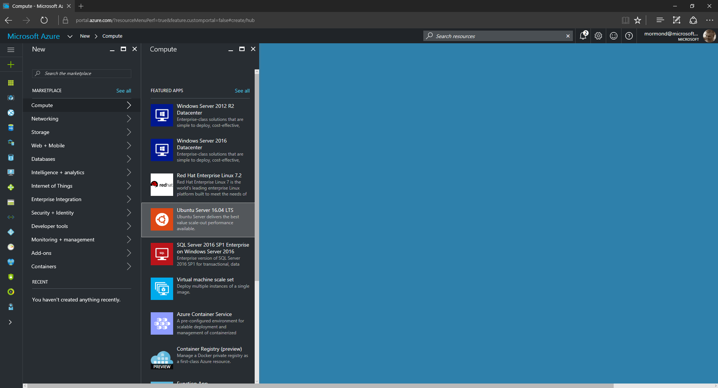

Slide 27
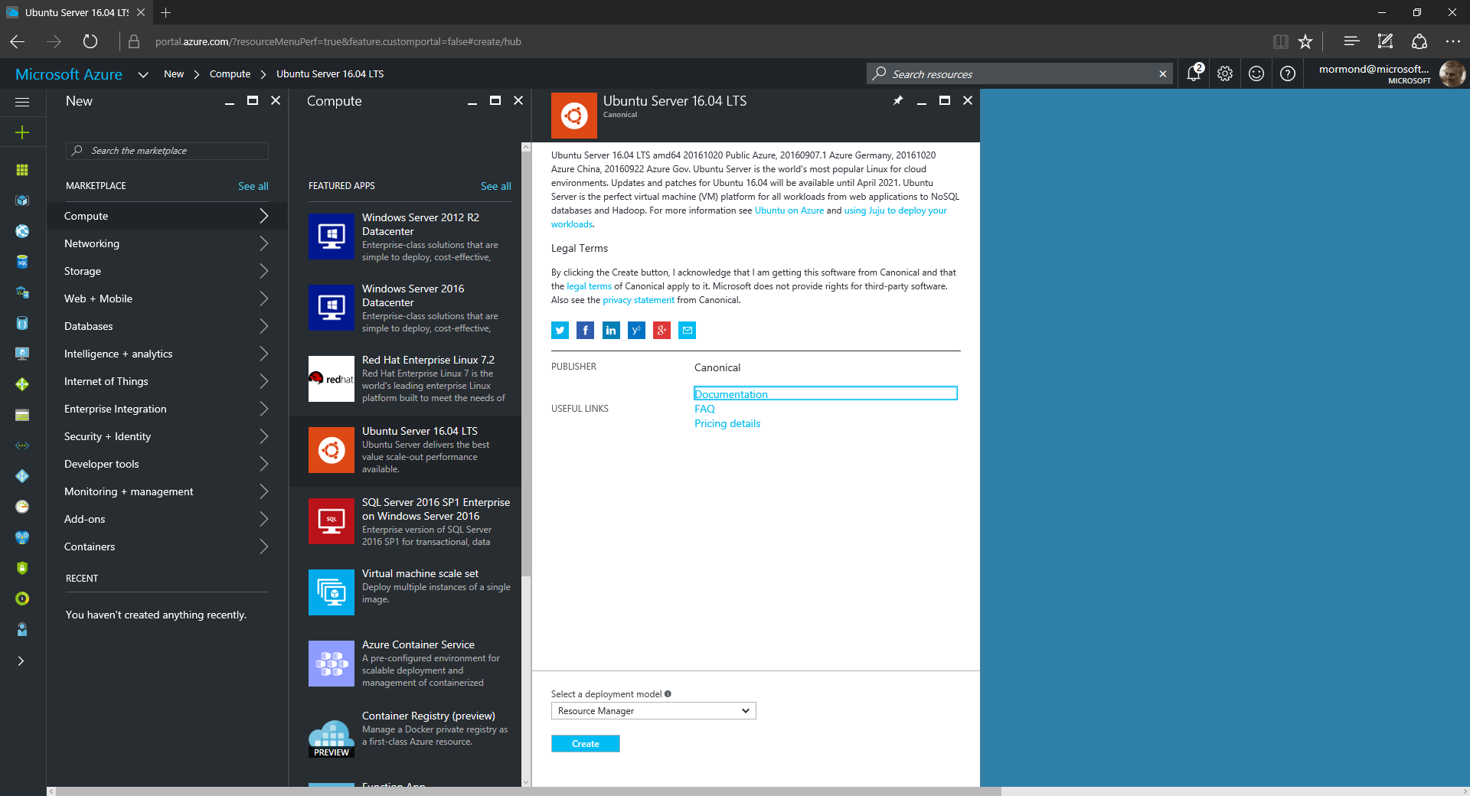

Slide 28
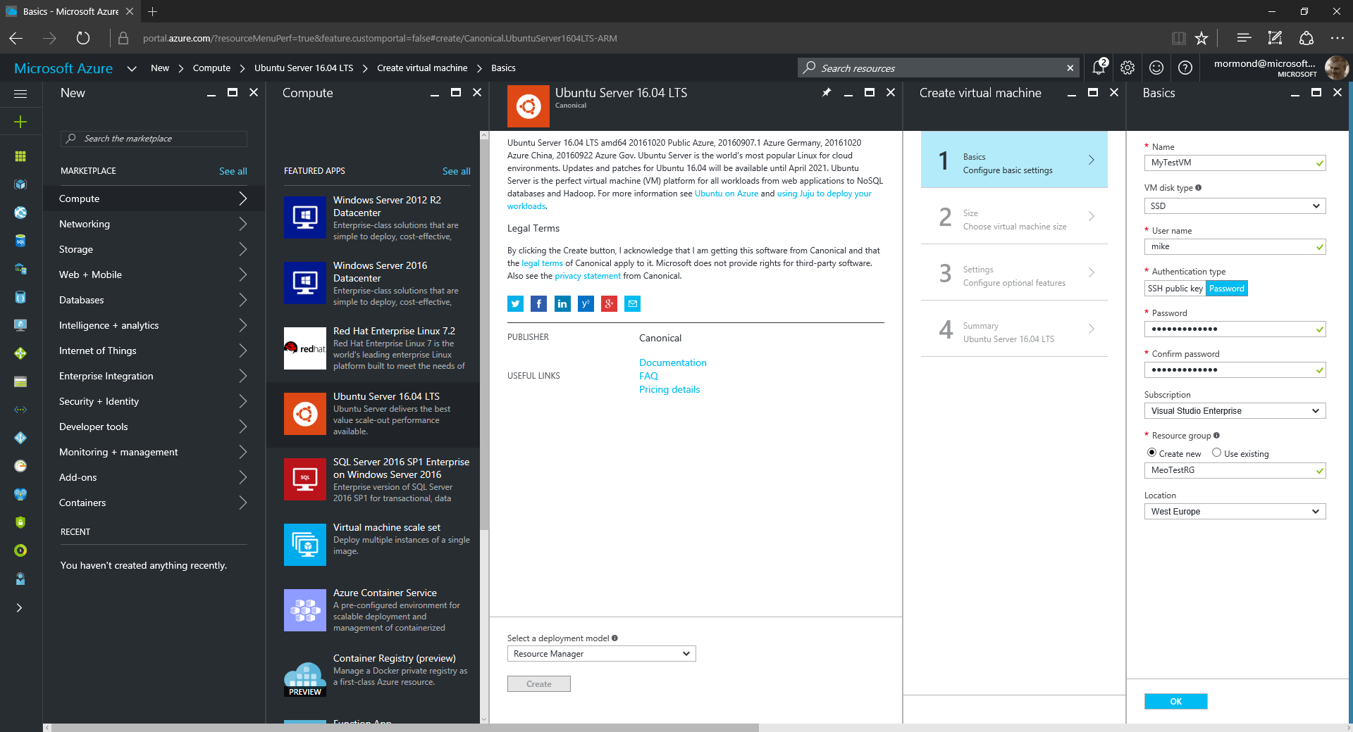

Slide 29
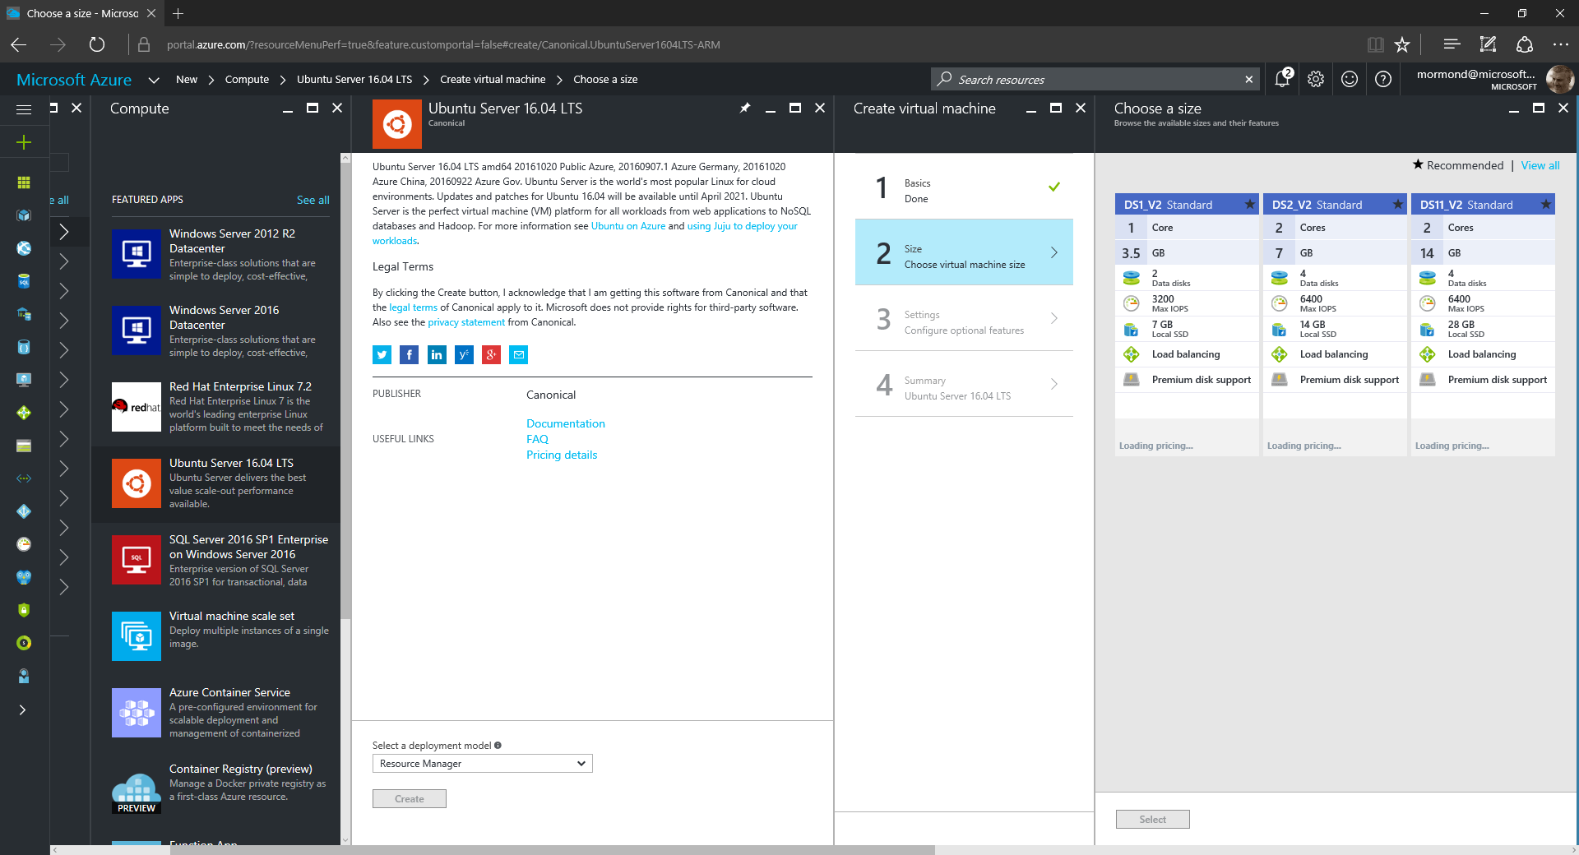

Slide 30
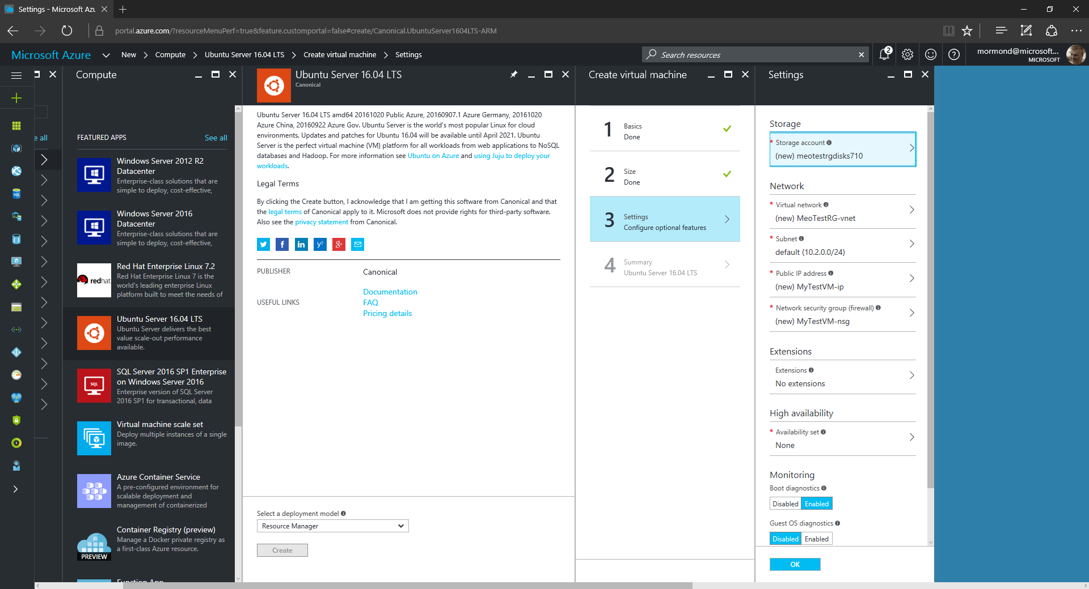

Slide 31
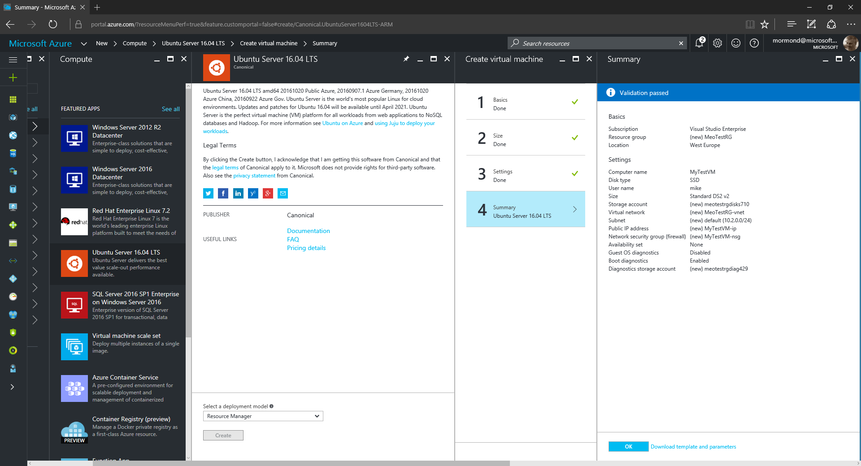

Slide 32
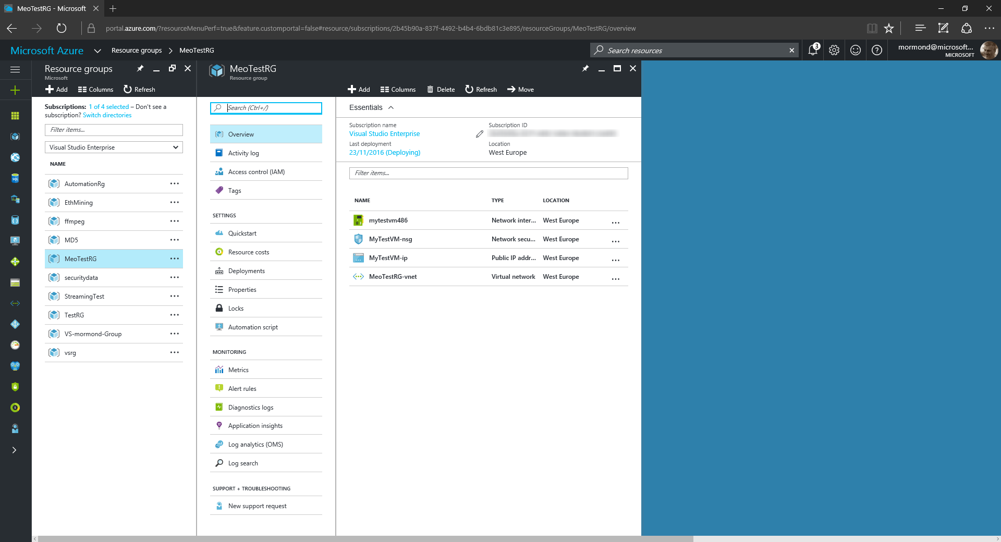

Slide 33


Slide 34
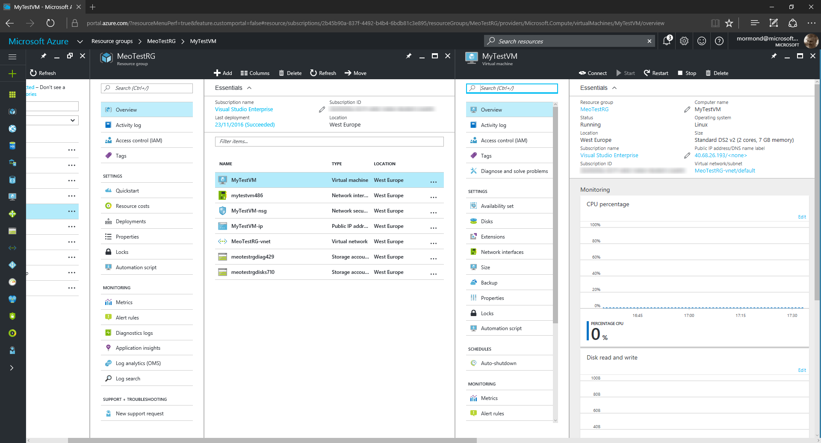

Slide 35
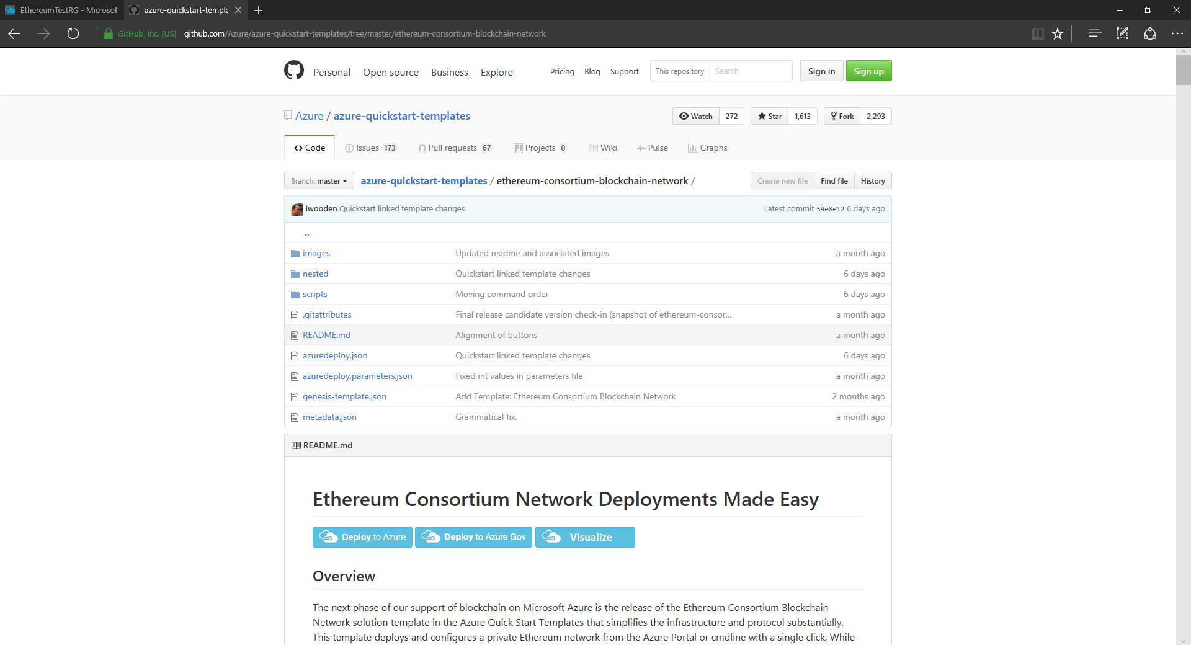

Slide 36
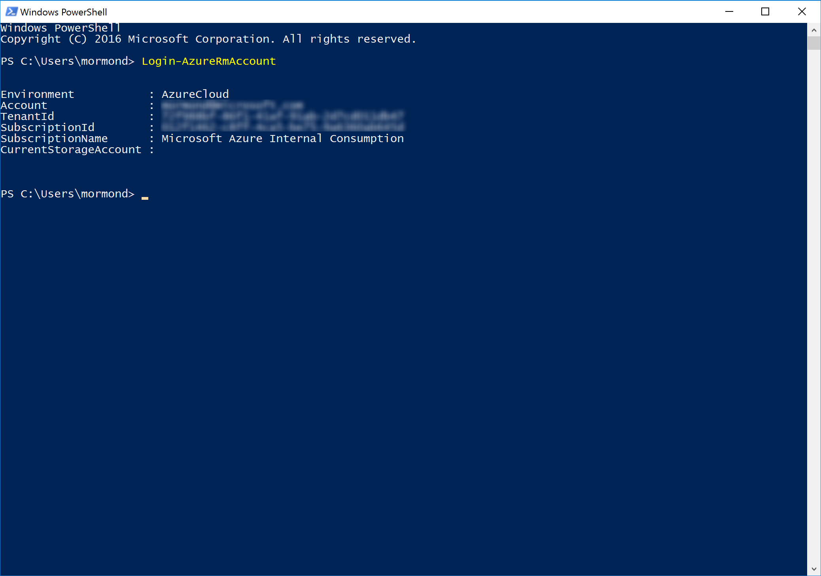

Slide 37
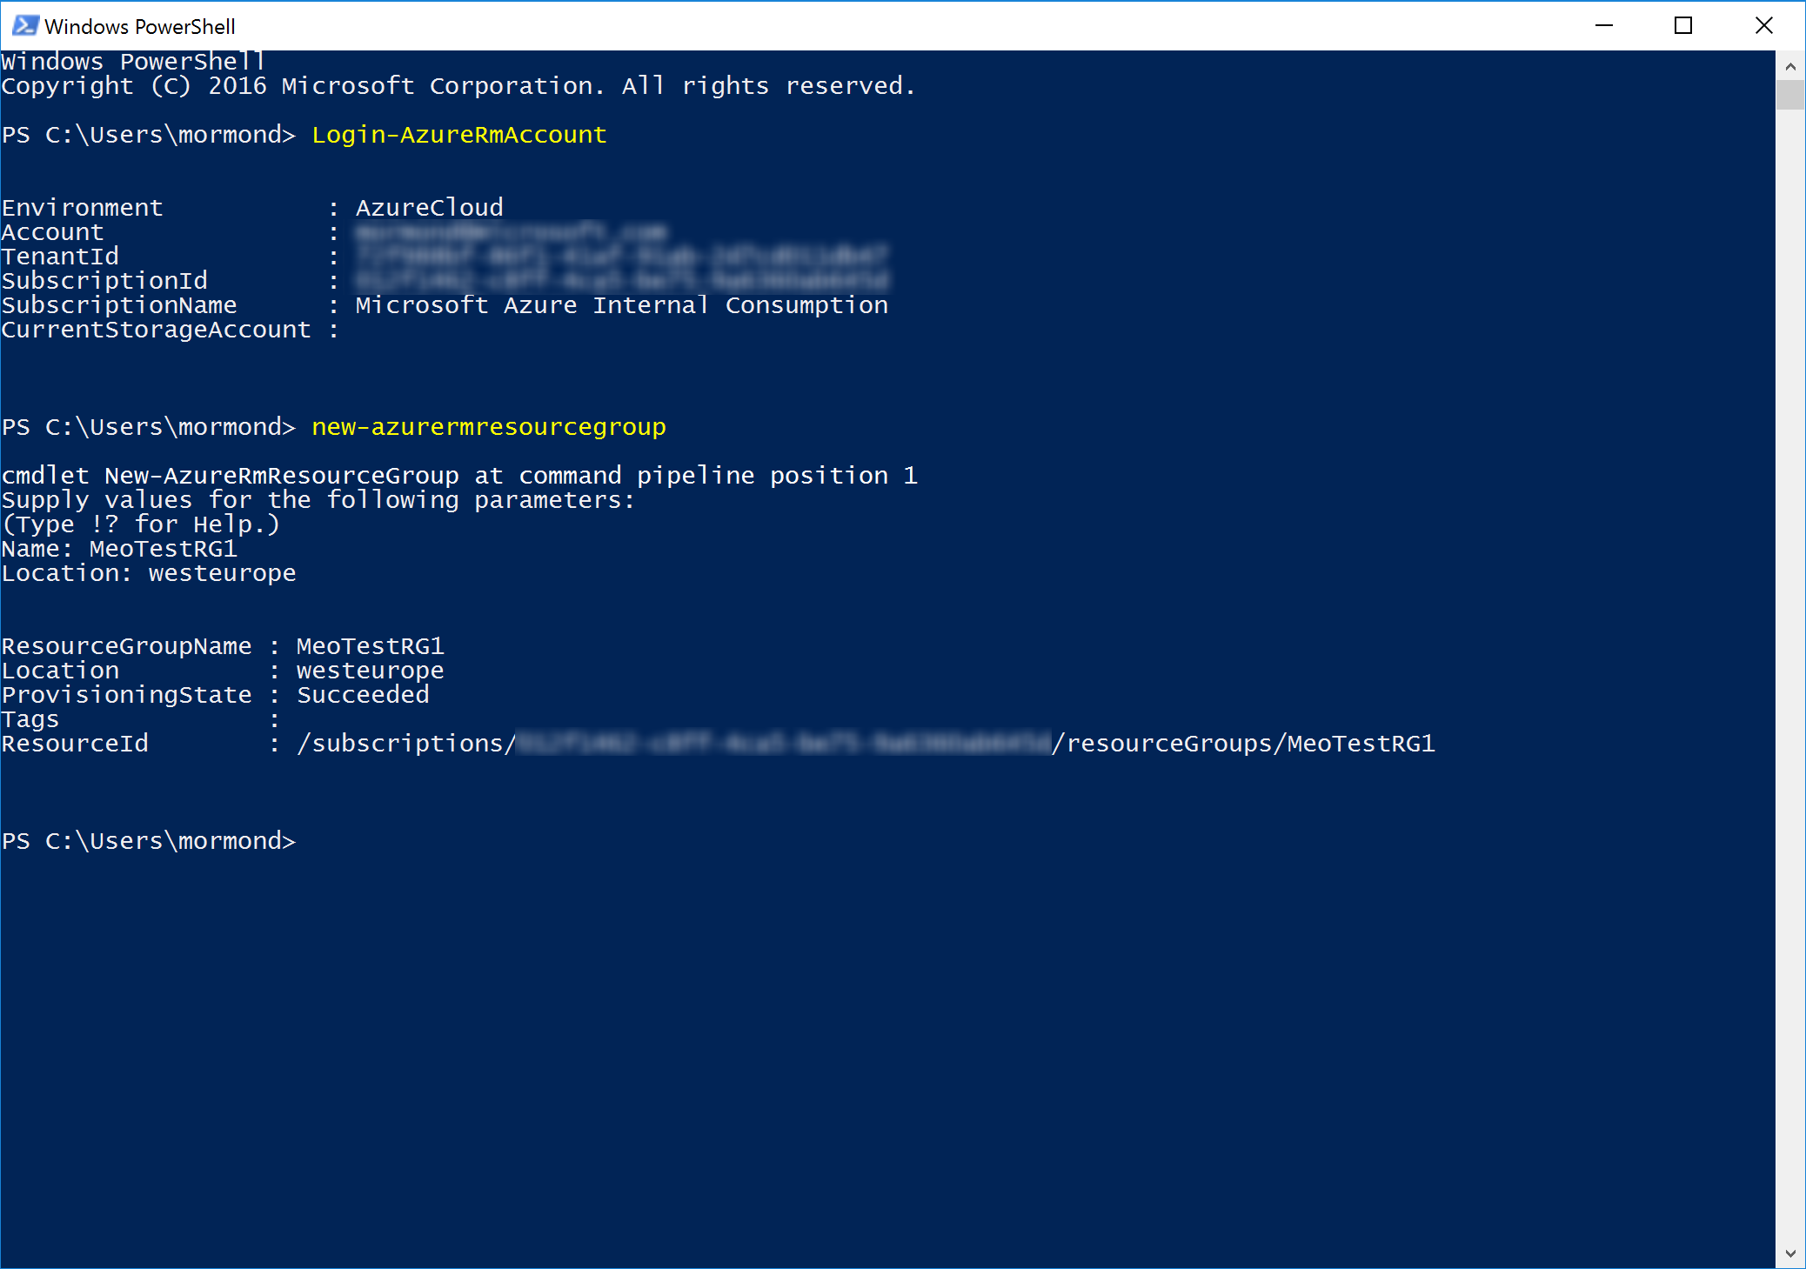

Slide 38
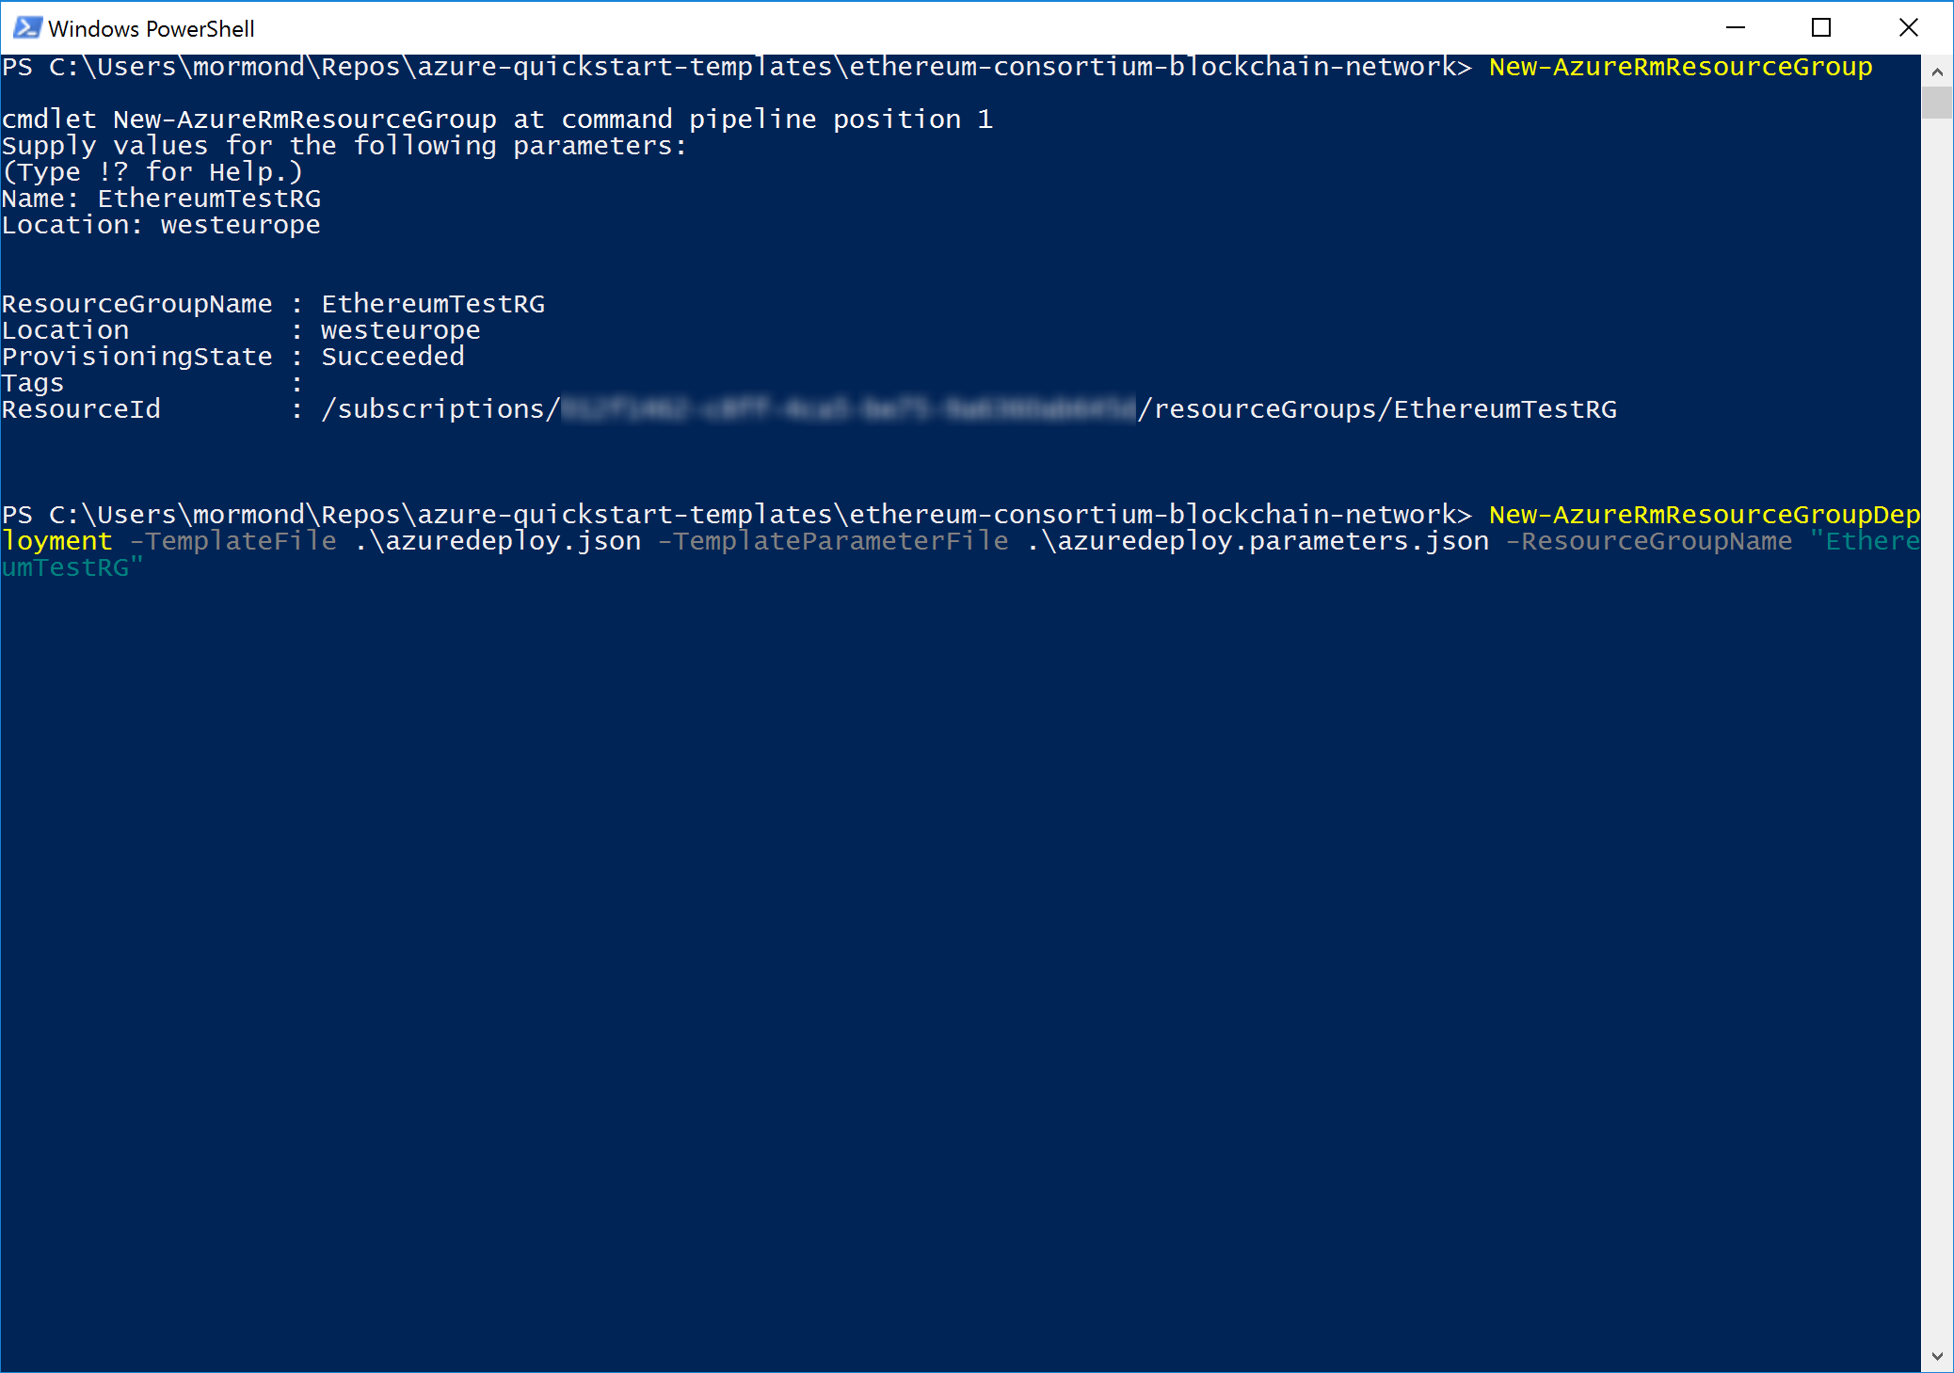

Slide 39
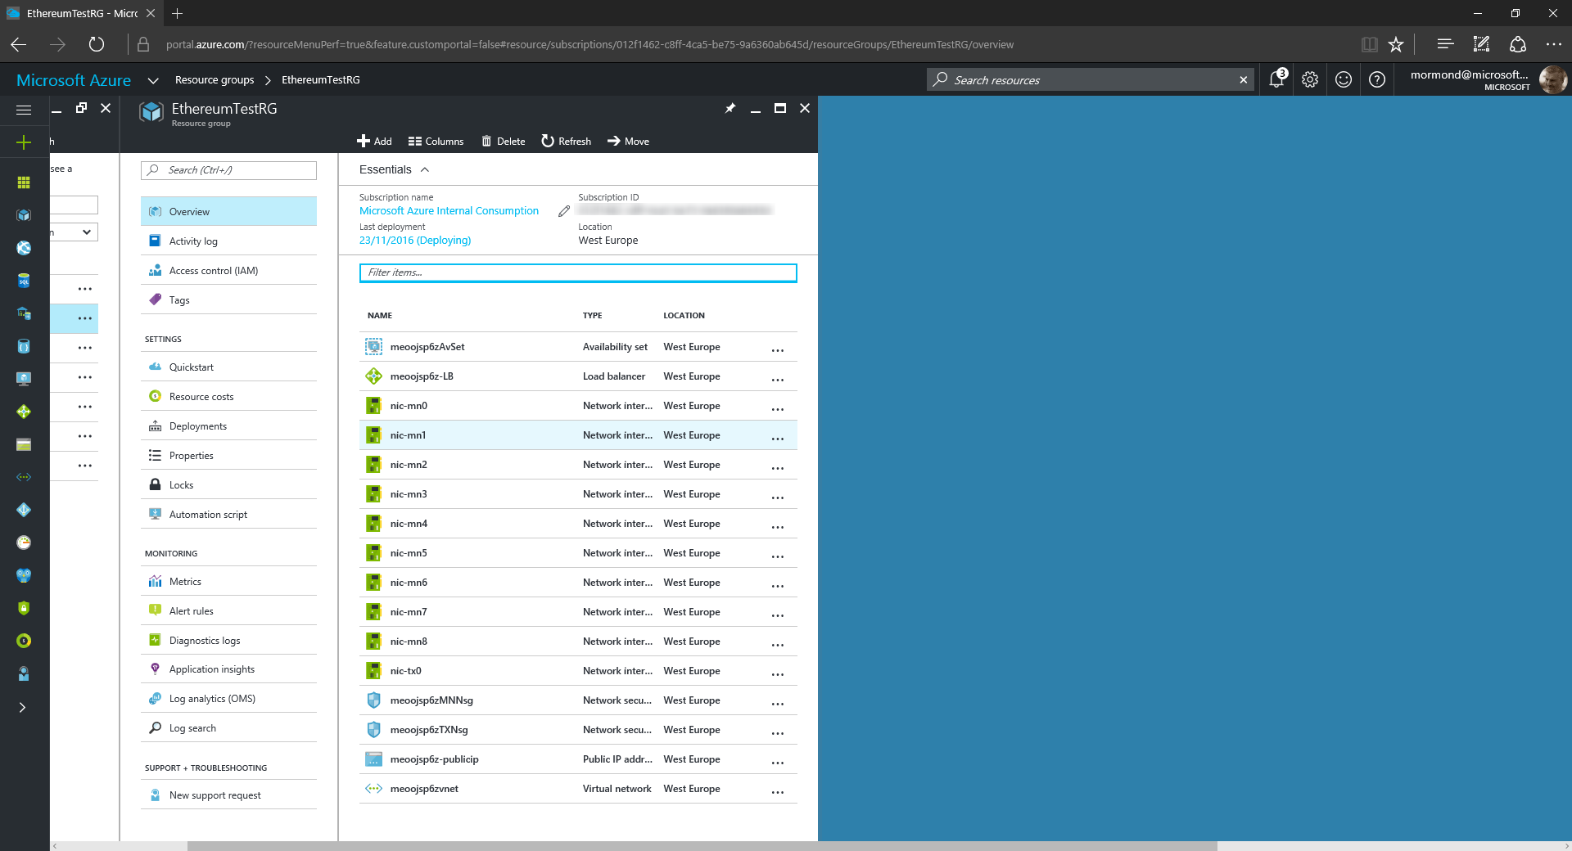

Slide 40
Summary

Slide 41
Useful resources
azure.microsoft.com is your starting place
channel9.msdn.com/shows/Cloud+Cover &
channel9.msdn.com/Shows/Azure-Friday for great videos
azure.microsoft.com/blog for latest news

Slide 42
Thank you

